Slide 1


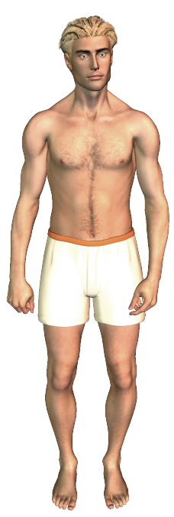
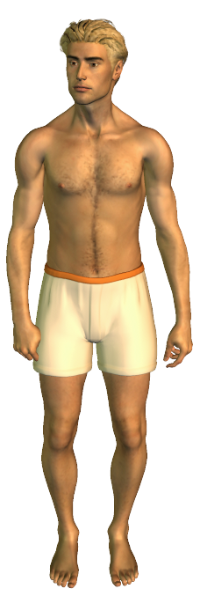
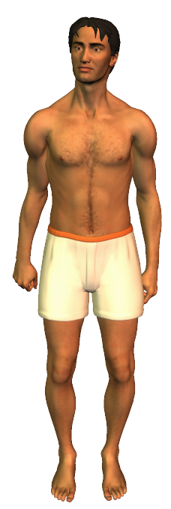
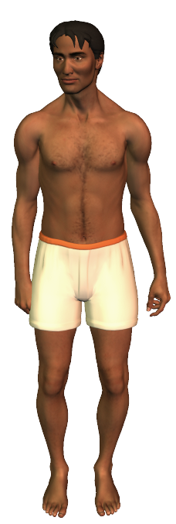
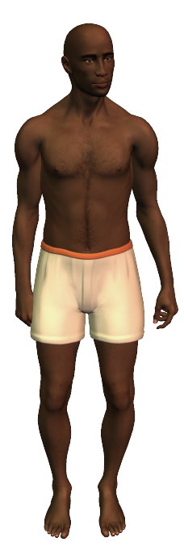

Genes & Inheritance Series: Set 5
Copyright © 2005
Version: 2.0

Slide 2
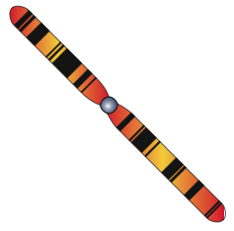
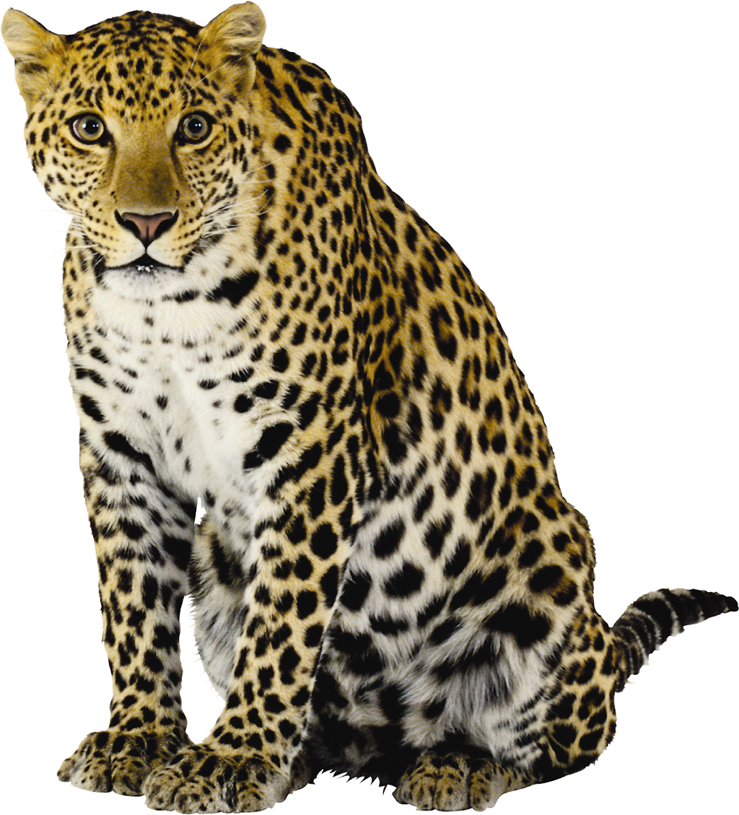

Genotype and Phenotype
The appearance of an organism is the result of two forces:
  The expression of the genes.
  The influence the environment has had on the expression of the genes.
Genotype
  Includes all the information in the genes of the organism’s genome.
  Some of this may be in the form of recessive genes that have no observable effects in the individual.

Slide 3



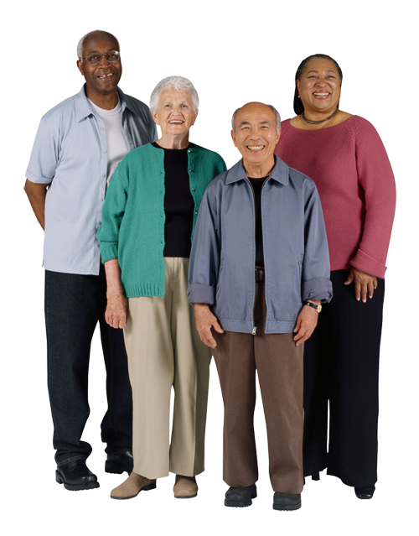





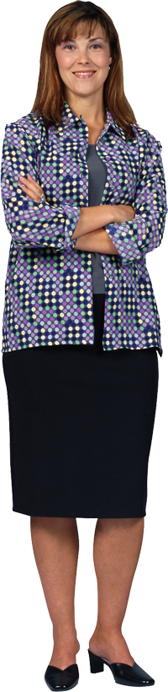

Genotype and Phenotype
The phenotype is a combination of:
  The genes that are expressed.
  All the environmental influences from the moment that the egg is fertilized.
Environment contributes most obviously to the phenotypic range of those characteristics where there is not a rigidly defined phenotype associated with a particular genotype, e.g. skin color.

Slide 4

Gene Interactions
Genes do not always interact. One gene may control the expression of a single trait with no input from other genes.
Some genes may interact so that one gene influences the effects of another.
  Pleiotropy: A single gene controls more than one trait in the phenotype of an organism.
  Polygeny: A single trait may be controlled by more than one gene.
Genes
Product
Character
Pleiotropy
Several characters are affected by the single gene
Protein synthesis
Polygeny
Several genes control the expression of the same character
No interaction
Some genes only control the expression of a single character with no other input from other genes

Slide 5
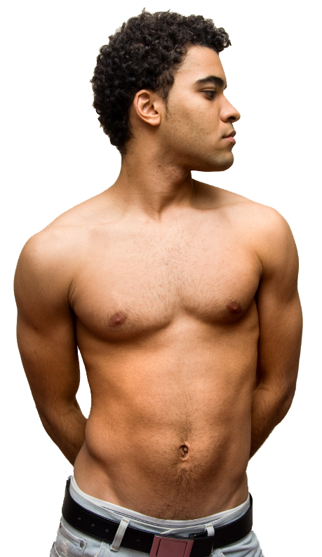


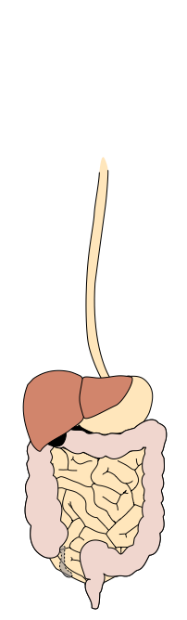
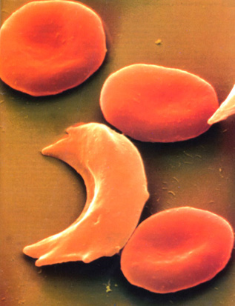
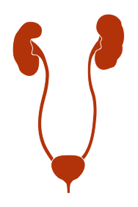
Pleiotropy
A single gene may produce a product that influences a number phenotypic characteristics. The sickle cell mutation in humans has such pleiotropic effects:
  A point mutation in the gene coding for the beta
  chain in the hemoglobin molecule produces an
  abnormal hemoglobin which crystallizes when
  oxygen content is low. This shape change
  deforms the red blood cells into a
  sickle shape (below).
  The deformed cells block
  circulation and this has
  multiple effects on the
  body’s organ systems.
Photo Defiers.com

Slide 6

Sickle Cell Effects
Sickled cells
Breakdown of red blood cells
Clumping of cells and clogging of blood vessels
Accumulation of sickle cells in the spleen
Weakness and fatigue
Anemia
Heart failure
Brain damage
Pain and fever
Damage to other organs
Damage to spleen
Impaired mental function
Stroke and paralysis
Pneumonia and other infections
Rheumatism
Kidney failure

Slide 7
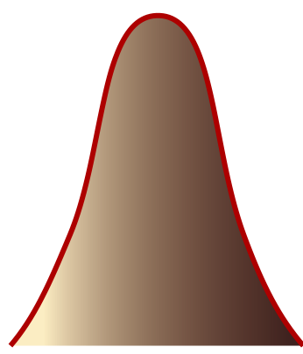
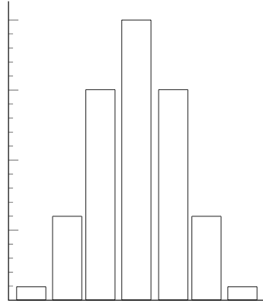
Polygeny
A single phenotypic character may be determined by two or more genes.
This is termed polygenic inheritance. It is usually indicated by characters that show quantitative variation in a population.
Example: Skin pigmentation in humans is controlled by at least three separately inherited genes.
  For each gene, an allele for dark skin
  (A,B,C) is incompletely dominant to the
  alleles for light skin (a,b,c).
  The alleles have a cumulative effect.
  Polygeny produces a normal
  distribution of phenotypic variation.
  The histogram is smoothed into a
  bell-shaped curve by environmental
  effects on skin color.
20/64
15/64
Frequency
6/64
1/64
Light
Skin color
Dark

Slide 8
Polygeny in Skin Color
The principle of polygenic inheritance of skin color can be simply illustrated if two, rather than three genes, are shown.
  The amount of melanin
  (dark) pigment produced
  is controlled by the number
  of dominant alleles of each
  of the genes.
  Even with just two genes
  involved, there are five
  possible phenotypes
  represented by nine
  possible genotypes.
  Within each genotype, skin
  color is also influenced by
  environmental effects.
White
Light
Medium
Dark
Black
aabb
Aabb
aaBb
Aabb
AaBb
aaBB
AaBB
AABb
AABB

Slide 9



Skin Color in Humans
In a cross involving parents who are homozygous for either light or dark skin color, the first generation children will have a medium skin color.
  When two genes are considered, the F2 generation
  offspring are produced in a 1: 4 : 6 : 4 : 1 ratio.
Sperm
AB
Ab
aB
ab
AABB Black | AABb Dark | AaBB Dark | AaBb Medium
AABb Dark | AAbb Medium | AaBb Medium | Aabb Light
AaBB Dark | AaBb Medium | aaBB Medium | aaBb Light
AaBb Medium | Aabb Light | aaBb Light | aabb White
Parent generation
AB
X
Ab
Black (AABB)
White (aabb)
Eggs
aB
ab
Medium (AaBb)
F1 generation
Breeding an F1 with an identical phenotype produces the F2 generation

Slide 10
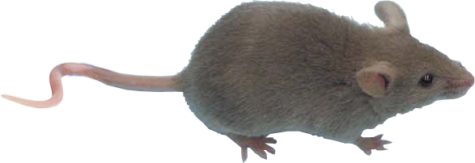
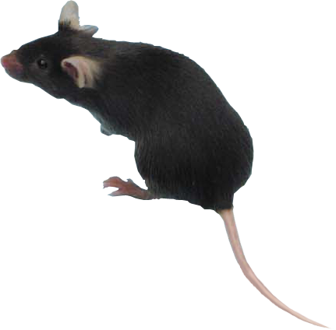
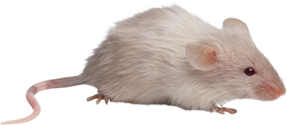
Epistatic Interactions
Epistatic genes mask or otherwise alter the effect of other genes. Epistasis occurs between non-allelic genes controlling coat color in mice.
  One of these genes (C) controls melanin production. A genotype that is homozygous recessive for coat color (cc) produces no pigment, regardless of the other genes present. The gene for color (C)is called the epistatic gene.
  The hypostatic gene (B) is responsible for whether the color is black or brown.
_ _cc
bbC_
B_C_
Albino (white)
No melanin produced
Brown
Mice with genotype bb are brown
Black
A dominant B allele produces black
BBcc
Bbcc
bbcc
bbCC
bbCc
BBCC
BbCC
BBCc
BbCc

Slide 11


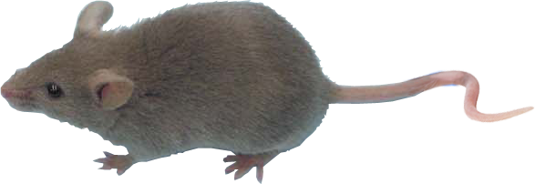


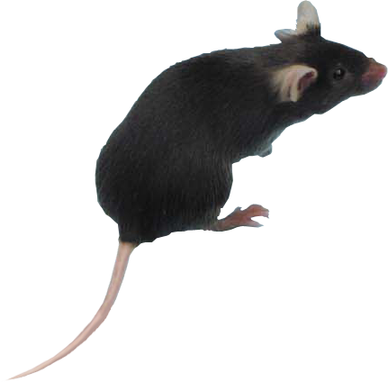
Epistasis in Mice
Melanin is synthesized in a pathway from the amino acid tyrosine.
  Gene C codes for tyrosinase, which converts tyrosine to melanin.
  Gene B codes for a tyrosine-related enzyme (TYRP1), which determines the level of pigment expression.
  The homozygous recessive condition of gene C blocks the expression of the other color genes, and results in the condition we call albinism.
Gene C
Gene B
Brown
bbC_
Tyrosinase
TYRP1
Albino
_ _cc
Black
Tyrosine
Melanin
B_C_

Slide 12
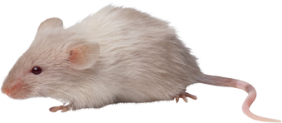
F2 Ratios involving Epistasis
In a cross involving brown and white mice which are true breeding for the alleles involved, the F1 generation will all be black.
  The F2 generation offspring are produced
  in a 9: 3 : 4 ratio of black : brown : white
Sperm
BC
Bc
bC
bc
BBCC Black | BBCc Black | BbCC Black | BbCc Black
BBCc Black | BBcc White | BbCc Black | Bbcc White
BbCC Black | BbCc Black | bbCC Brown | bbCc Brown
BbCc Black | Bbcc White | bbCc Brown | bbcc White
Parent generation
BC
X
Bc
Brown (bbCC)
White (BBcc)
Eggs
bC
bc
F1 generation
Black (BbCc)
F2 generation
If the F1 is inbred (matings with siblings), the F2 are produced in a 9 : 3 : 4 ratio.

Slide 13
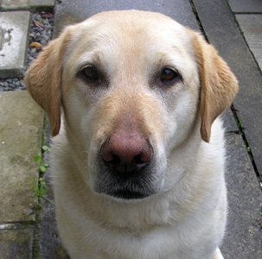
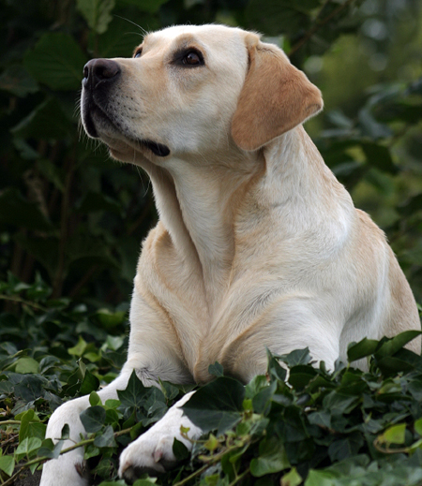
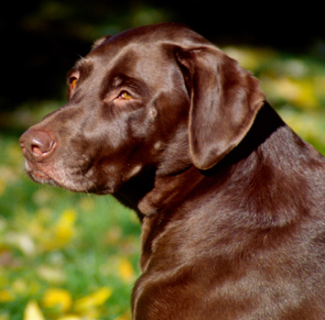
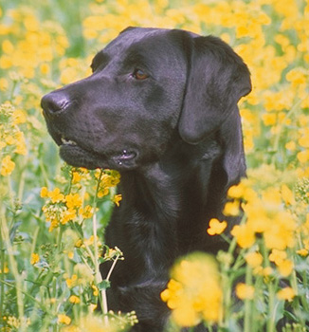
Coat Color in Dogs
The coat color in labrador dogs is an example of an epistatic interaction of two genes at different loci, each with two alleles. The E gene determines if the pigment will be deposited in the fur, and the B gene determines how dark the pigment will be.
The presence of bb modifies the effect of dark pigment in the fur.
ee
E_
No dark pigment in fur
Dark pigment in fur
Yellow lab
E_bb
E_B_
eebb
eeB_
Chocolate lab
Black lab
Yellow fur, brown nose, lips, eye rims
Yellow fur, black nose, lips, eye rims
Brown fur, nose, lips, and eye rims
Black fur, nose, lips, and eye rims

Slide 14
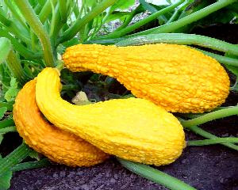
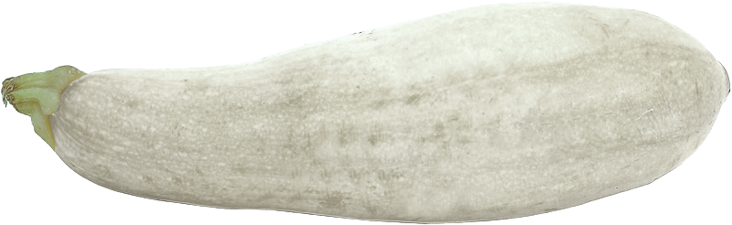
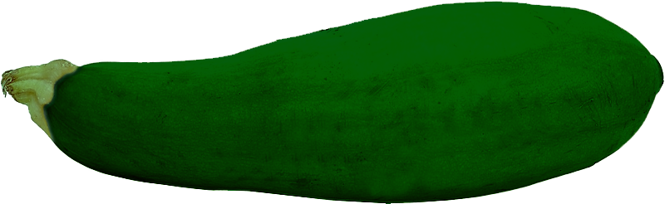
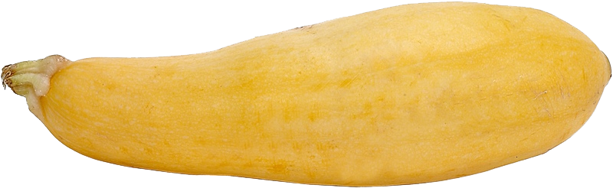
Epistasis in Squash
In varieties of summer squash, white fruit color is governed by a dominant gene (W) and colored fruit by the recessive (w). Yellow fruit is determined by a hypostatic gene (G) and green by its recessive allele (g).
W is said to be an inhibitor gene because the presence of a dominant W prevents the expression of the G genes.
  Gene G controls production of the yellow pigment from a green pigment.
  Gene W prevents the production of the green pigment.
White (W_ _ _)
Yellow (wwG_)
Green (wwgg)

Slide 15
Epistasis in Squash
Gene G controls production of the yellow pigment from a green pigment.
Gene W prevents the production of the green pigment.
  The presence of a single dominant W allele results in a white fruit.
  Plants homozygous recessive for both genes are green.
White (W_ _ _)
Yellow (wwG_)
Green (wwgg)
WwGG
WWGg
WwGg
WWGG
Wwgg
WWgg
wwGG
wwGg
wwgg

Slide 16
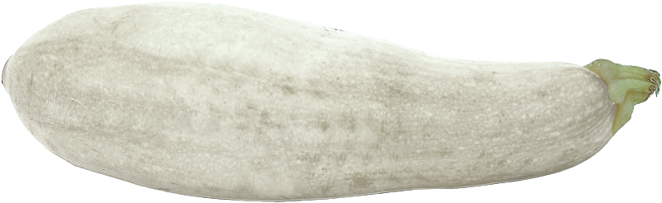
Skin Color in Squash
In a cross between parent plants true breeding for both genes, the F1 generation are all white heterozygous.
The presence of inhibitor genes
results in a dihybrid F2 ratio of
12 : 3 : 1 of white : yellow : green.
Pollen
Wg
wG
WG
wg
WWGG White | WWGg White | WwGG White | WwGg White
WWGg White | WWgg White | WwGg White | Wwgg White
WwGG White | WwGg White | wwGG Yellow | wwGg Yellow
WwGg White | Wwgg White | wwGg Yellow | wwgg Green
WG
Wg
Parent generation
Ova
X
wG
White (WWGG)
Green (wwgg)
wg
The F2 are produced in a 12 : 3 : 1 ratio.
White (WwGg)
F1 generation
F1 are inbred to produce the F2 generation

Slide 17


Complementary Genes
In some cases of epistasis, some genes can only be expressed in the presence of other genes.
The genes are said to be complementary; both genes need a dominant allele for the final end product of the phenotype to be expressed.
  This interaction occurs in the control of some flower colors. The enzyme product of two genes is required to produce a colored pigment.
  Typically, there are two phenotypes produced in this interaction.
Gene A
Gene B
Enzyme A
Enzyme B
Precursor
(colorless)
Intermediate
(colorless)
End product
(purple)
Gene A produces an enzyme that controls the production of a colorless intermediate substance
Gene B produces an enzyme that converts the intermediate into a purple pigment
aaBB
aaBb
aabb
Aabb
AAbb
AaBB
AABb
AaBb
AABB

Slide 18
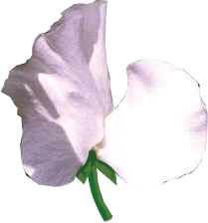

Flower Color in Peas
Purple color in sweet pea flowers is controlled by complementary genes. Purple is produced only when a dominant allele for each gene is present.
  There are two possible phenotypes with this interaction.
  The F2 generation offspring are
  produced in a 9 : 7 ratio.
Pollen
AB
Ab
aB
ab
AABB | AABb | AaBB | AaBb
AABb | AAbb | AaBb | Aabb
AaBB | AaBb | aaBB | aaBb
AaBb | Aabb | aaBb | aabb
AB
Parent generation
X
White (AAbb)
White (aaBB)
Ab
Ova
aB
Purple (AaBb)
ab
F1 generation
F1 are inbred to produce the F2 generation
The F2 are produced in a 9 : 7 ratio.

Slide 19
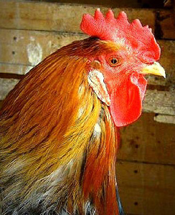
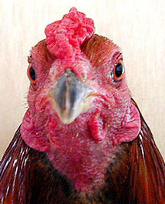
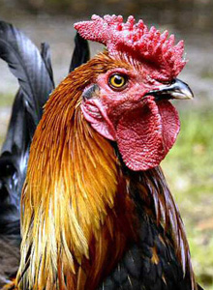
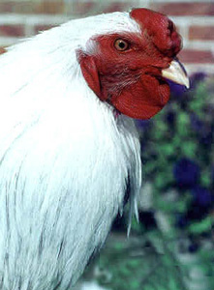
Collaboration 1
In some cases, two non-allelic genes influence the same trait, but interact to produce a phenotype that could not result from the action of either gene independently.
These are collaborative genes and the interaction is collaboration.
With two genes involved, there are typically four phenotypes possible with this interaction.
  A well studied example is the comb shape of domestic chickens.
Photo: Marc King
Single comb
Pea comb
Rose comb
Walnut comb

Slide 20
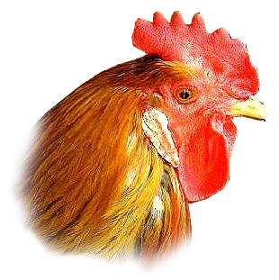
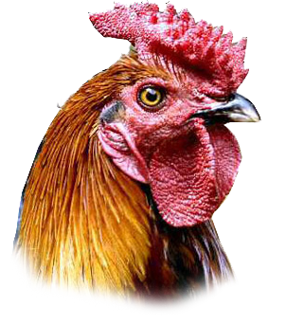
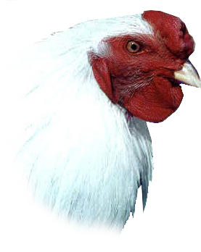
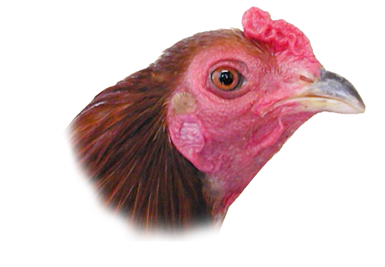
Collaboration 2
Comb shape in poultry is controlled by two non-allelic genes P and R. The genes show independent expression, but interact to produce a new trait.
  Both of genes in the recessive state (rrpp) produces a single comb.
  When P alone is dominant (rrP_), pea comb is produced.
  When R alone is dominant (R_pp), rose comb is produced.
  If dominant alleles of both are present together, (R_P_), the result is a walnut comb.
Single comb
Pea comb
Rose comb
Walnut comb
rrpp
rrPP
rrPp
RRpp
Rrpp
RRPP
RrPP
RRPp
RrPp

Slide 21
Comb Shape in Chickens
The dihybrid F2 produces comb shapes in a is 9:3:3:1 ratio of walnut : rose : pea : single.
Sperm
RP
Rp
rP
rp
Parent generation
RRPP Walnut | RRPp Walnut | RrPP Walnut | RrPp Walnut
RRPp Walnut | RRpp Rose | RrPp Walnut | Rrpp Rose
RrPP Walnut | RrPp Walnut | rrPP Pea | rrPp Pea
RrPp Walnut | Rrpp Rose | rrPp Pea | rrpp Single
RP
X
X
Rp
Pea (rrPP)
Rose (RRpp)
Eggs
rP
rp
F2 generation
F1 generation
If the F1 is inbred (matings with siblings), the F2 are produced in a 9 : 3 : 3 : 1 ratio.
Walnut (RrPp)

Slide 22
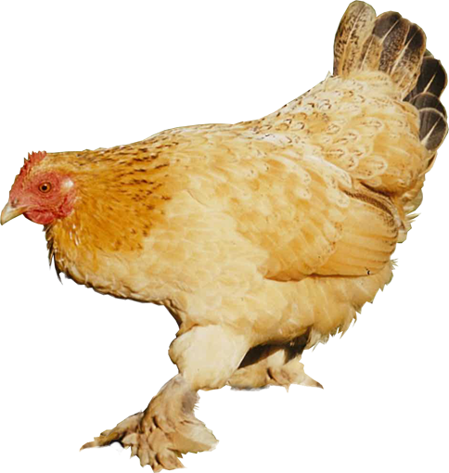
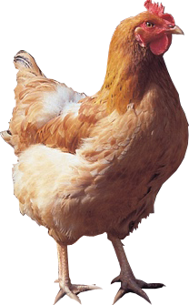
Duplicate Genes
Duplicate genes are additional copies of the same gene found at different loci.
  Duplicate genes influence the same trait, but alter the ratios in the offspring.
  The dominant alleles of both loci each produce the same phenotype without cumulative effect.
The genes for leg feathers in chickens show the effect of duplicate dominant genes.
  The featherless leg phenotype is seen only in chickens that are homozygous recessive for both of the genes involved.
Feathered legs
Unfeathered legs

Slide 23

Duplicate Genes
The featherless leg phenotype is recessive and is expressed only in the homozygous recessive condition.
  Any dominant allele from gene A or B will produce feathered legs.
    There are two possible phenotypes for this condition.
aabb
AABB
AaBb
AAbb
aaBB
AaBB
AABb
Aabb
aaBb
Unfeathered legs
Feathered legs

Slide 24
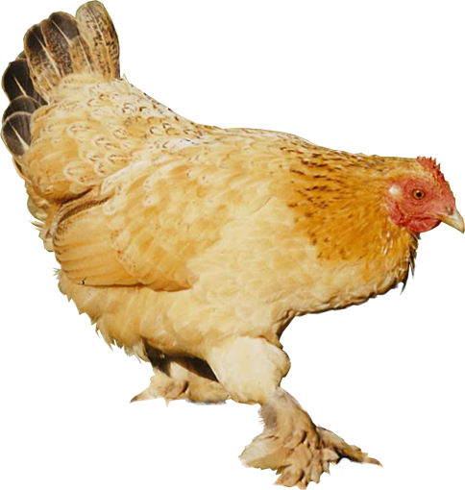
Leg Feathers in Chickens
The presence of duplicate genes modifies the dihybrid F2 ratio to 15 : 1 feathered : featherless.
Sperm
AB
Ab
aB
ab
AABB Feathers | AABb Feathers | AaBB Feathers | AaBb Feathers
AABb Feathers | AAbb Feathers | AaBb Feathers | Aabb Feathers
AaBB Feathers | AaBb Feathers | aaBB Feathers | aaBb Feathers
AaBb Feathers | Aabb Feathers | aaBb Feathers | aabb No feathers
Parent generation
AB
X
Ab
Featherless legs (aabb)
Feathered legs (AABB)
Eggs
aB
ab
F1 generation
F2 generation
Feathered legs (AaBb)
If the F1 is inbred (matings with siblings), the F2 are produced in a 15 : 1 ratio.

Slide 25
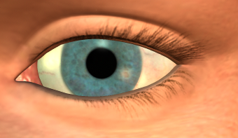
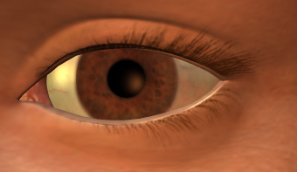
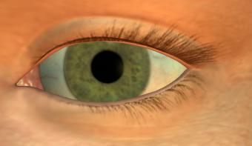
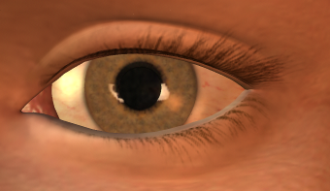

The Action of Modifiers
The color of human eyes is determined by the amount of melanin in the iris of the eye.
  If a lot of melanin is present, the eye will appear brown or even black.
  If very little melanin is present the iris appears blue.
  Intermediate amounts of melanin produces gray, green, hazel or varying shades of brown.
Determination of eye color is complex. At least three genes have been identified, accounting for blue, brown, and green eyes.
  Modifier genes then have the capacity to affect the final phenotype by altering:
    the amount of pigment in the iris
    the pigment tone
    the distribution of the pigment

Slide 26
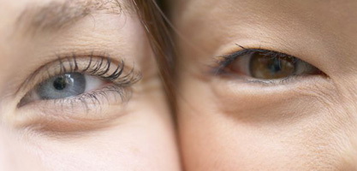
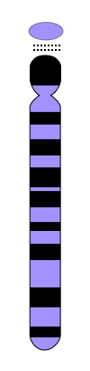

The Genetics of Eye Color
At present, three gene pairs controlling human eye color are known. Two of these genes are:
  The bey 2 gene, on chromosome 15, has a brown and a blue allele.
    The brown allele is dominant to blue.
  A second gene, located on chromosome 19 (the gey gene) has a blue and a green allele.
    The green allele is dominant to the blue allele on either chromosome but is recessive to the brown allele on chromosome 15.
  Blue eyes occur if all four alleles are for blue eyes.
  This two gene model explains the inheritance of blue, brown, and green eyes but cannot account for gray, hazel or multiple shades of brown, blue, or green eyes. Additional eye color genes and modifier genes are almost certainly involved.
Chromosome 15
Chromosome 19
bey2
gey1
*A third gene, bey1, also on chromosome 15, is a central brown eye color gene

Slide 27
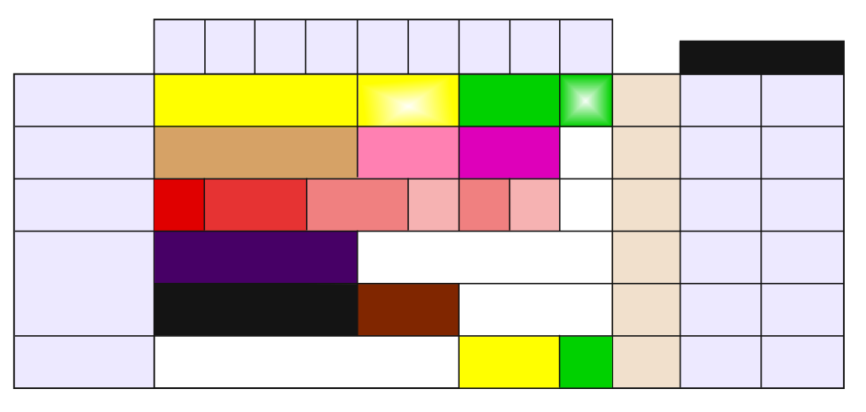
Types of Gene Interaction
Number of offspring with this genotype
Possible genotypes from AaBb x AaBb cross
Ratio of offspring with each phenotype
Example
Type of gene
interaction
AABB
1
AABb
2
AaBB
2
AaBb
4
AAbb
1
Aabb
2
aaBB
1
aaBb
2
aabb
1
Dihybrid
ratio
No interaction
Yellow round
Yellow wrinkled
Green round
Green wrinkled
9:3:3:1
Peas
Seed color
Seed shape
Collaboration
Walnut
Rose
Pea
Single
9:3:3:1
Chickens
Comb shape
Polygenes
Dark red
Medium dark red
Medium red
Light red
Medium red
Light red
White
1:4:6:4:1
Wheat
Kernel color
Epistasis
complementary genes
Purple
White
9:7
Sweet pea flowers
Color
Epistasis
supplementary genes
Black
Brown
White
9:3:4
Mice
Coat color
Epistasis
Inhibitor genes
White
Yellow
Green
12:3:1
Squash
Color
12 of the 16 offspring are likely to be white
3 of the 16 offspring are likely to be yellow
1 of the 16 offspring are likely to be green
Similar shading indicates genotypes with similar phenotypes. In this example, any with a dominant A.

Slide 28
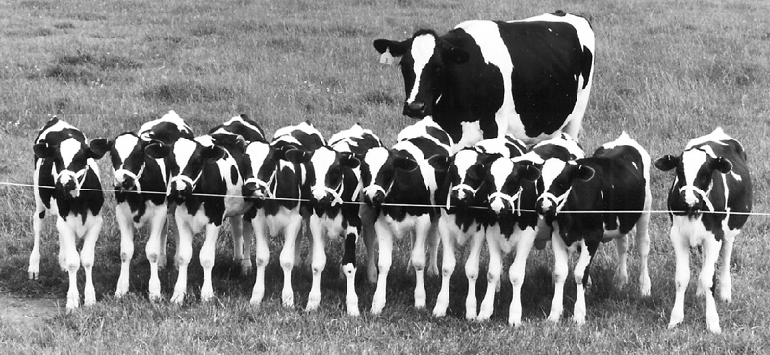
Genes and Environment
Environmental factors have a role in modifying the phenotype encoded by genes, both in embryonic development and in later life.
  Genotype: Provides the genetic potential (a possible phenotype).
  Environmental factors: Act on the organism to produce a unique phenotype.
    Even identical twins will differ in their appearance as a result of environment.
Photo courtest of Dr David Wells, AgResearch, NZ
Even these cloned calves (effectively identical twins) show different coat patterns as a result of random pigment migration during embryonic development.

Slide 29

Environmental Influences on Gene Expression
Environmental factors may be external, including:
  Wind exposure, water availability
  Light and temperature
  Soil type and pH
  Nutrition, predation and symbiotic associations (right)
  Chemical factors in the environment
Environmental factors may also be internal, including:
  Hormone levels during development
With mycorrhizae
Photo courtesy Warwick Sylvester
Without mycorrhizae
Clover growth with and without fungal (mycorrhizal) associations

Slide 30



Environmental Influences on Phenotype
Source of
Genetic Variation
Genotype
Dominant alleles
Recessive alleles
Mutations
Crossing over
Independent assortment
Gene interactions
Provides
inherited variation
Combine in their effects
Source of
Environmentally Induced Variation
Wind
Water availability
Acidity
Temperature
Soil type
Light
Predation
Provides
non-inherited variation
Phenotype
The resulting phenotype is the product of the effects of the environment on genetic potential
Environment

Slide 31


Temperature Effects on Phenotype
Sex determination
  The sex of some animals is determined by the temperature at which they were incubated during embryonic development.
  Examples include American alligators, crocodiles, and turtles.
  In some species:
    high incubation temperatures produce males and low incubation temperatures produce females.
  In other species the opposite is true.

Slide 32


Temperature Effects on Phenotype
Color pointing
  Some breeds of cat and rabbit have distinctive darker fur on the extremities (called pointing).
  Pigment production is controlled by a temperature sensitive enzyme and only the extremities are cool enough to allow the enzyme to function.
  Examples include Siamese cats and Himalayan rabbits

Slide 33

Altitude Effects on Phenotype
Plants of the same species produce a smaller or stunted phenotype with higher altitude.
Such patterns are
observable in the
vegetation growing
on mountainsides.
This may be due to
the combined effects of:
  Wind exposure
  Cooler temperatures
  Water availability
  Rarified atmosphere
  (low oxygen)
Large trees growing to full height of their genetic potential
Some stunting of growth due to environmental effects
Severe stunting near the snowline

Slide 34


The Effects of Predation
The activity or presence of predators may cause a permanent change in the phenotype of the prey.
  Daphnia develop a large extension of the carapace, called a helmet, when exposed to the predatory phantom midge larva Chaoborus.
  This effect is mediated through chemicals produced by the predator.
    The large helmet makes it more difficult for the invertebrate predator to manipulate its prey.
    The helmet is clear, so does not increase the visible size of Daphnia to vertebrate predators (fish).
Helmet makes Daphnia more difficult to handle
Non-helmeted form
Helmeted form

Slide 35



Sex and Phenotype
The presence of other individuals of the same species may control the determination of sex in other individuals of the group.
  Some fish species, including Sandaggers wrasse (parrotfish) show this control over phenotype.
    These fish live in groups consisting of a single male with attendant females and juveniles.
    In the presence of the male, all juvenile fish of this species grow into females.
    When the male dies, the dominant
    female will change her sex to become a male for the group.

Slide 36


Effects of Light on Phenotype
Light (too much or too little) can alter an organism’s phenotype
  Plants of the same species will adopt different growth behaviors under different light regimes.
    Most plants will grow abnormally long stems and lack pigmentation
    if grown in low light levels. This phenomenon is known as etiolation.
  Human skin will tan (become browner) when exposed to direct sunlight over a period of time.
Photo courtesy of Laurie A.E. O'Meara)
Etiolation in geranium
Exposure to sunlight promotes deposition of melanin in the skin

Slide 37


Effects of pH on Phenotype
The color of some flowers is determined by the pH of the soil the plants grow in.
  Flower color in hydrangeas changes according to soil pH.
    In more acid soils (pH 5.0-5.5), flowers are blue.
    In more alkaline soils (pH 6.0-6.5), flowers are pink.
  The color is due to the presence of aluminum compounds in the flowers, and aluminum is more readily available when soil pH is low.
Acid soil will yield blue flowers.
Soil pH of 6.-6.5 soil will yield pink flowers. As pH approaches 6.0, flowers take on a magenta hue.

Slide 38


Chemical Effects on Phenotype
Harmful chemicals (called teratogens) can adversely affect phenotype.
There are many examples of babies born with deformities because of drugs or alcohol taken by the mother during pregnancy.
  The sedative drug thalidomide was promoted as an anti-nausea drug in the 1960s. It was found to interfere with limb development, leading to babies with severe limb deformities.
  Babies born to mothers who drink alcohol during pregnancy are at high risk of fetal alcohol syndrome. These babies have a suite of disorders including facial abnormalities and mental retardation

Slide 39


Slide 40
Terms of Use
Biozone International retains copyright to the intellectual property included in this presentation file, with acknowledgement that certain photos are used under license and are credited appropriately on the next screen.
You MAY:
  Use these slides for presentations in your classrooms using a data projector, interactive whiteboard, and overhead projector.
  Place these files on the school’s intranet (school computer network), but not in contradiction of clause 3 (a) below.
  Edit and customize this file by adding, deleting, and modifying information to better suit your needs.
  Place these presentation files on any computer within the school, including staff laptops.
  Print out this file in PowerPoint “Handouts” format as per the print dialogue box, for the express purpose of allowing students to make their own notes about the presentation.
You MAY NOT:
  Put these presentation files onto the internet or on a service that may be accessed offsite from the campus, unless access to the service is protected by a user login and password protocol.
  Print these files onto paper to make your own worksheets for distribution to students.
  Create a NEW document using any of the graphics/images in this presentation file.
  Incorporate any part of this presentation file for the production of another commercial product.
  REMOVE any of the references to Biozone, the copyright notices, photo credits, or terms of use from this file.

Slide 41
Photo Credits
Photographic images are used under licence from the following photo libraries:
  Corel Corporation Professional Photos
  (various titles, including: Science & Medicine, Agriculture).
  ArtToday.com
  Clipart.com
  PhotoDisc Inc.
  Hemera Technologies Inc.
  PhotoObjects.com
  CDC Public Health Image Library (PHIL)
Additional artwork and photographs are the property of Biozone International Ltd.
BIOZONE International Ltd | P.O. Box 13-034, 109 Cambridge Road, Hamilton, NEW ZEALAND
Phone: + 64 7 856-8104 | Fax: + 64 7 856-9243 | E-mail: sales@biozone.co.nz | Internet: www.biozone.co.nz
Copyright © 2005 Biozone International Ltd
All rights reserved

Slide 42







Presentation MEDIA
See our other titles:
See full details on our web site:
www.thebiozone.com/media.html

